Slide 1
OBJECT ORIENTED
ANALYSIS AND DESIGN
Ch - 5
Advanced Use case Modeling
A study material for the students of GLS University

Slide 2
Actor Generalization
Actor generalization is the process of defining a parent actor (super actor) that holds common interactions, and child actors that inherit those behaviors and may also have additional, specific use cases.
Why Use Actor Generalization?
To reuse common interactions.
To simplify complex use case diagrams.
To represent hierarchies like User → Admin/User/Guest.
To promote clarity and maintainability.

Slide 3
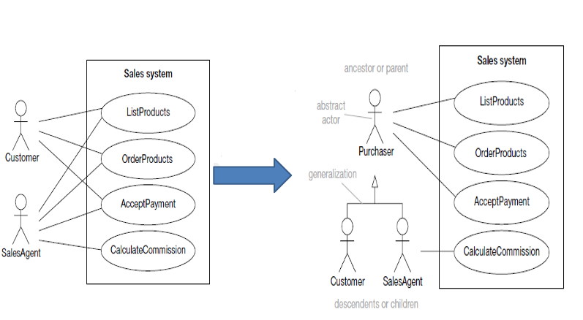
Example

Slide 4
Use case Generalization
Use case generalization allows you to:
Factor out common behavior from two or more similar use cases.
Place the shared logic in a parent use case.
Let child use cases inherit and extend or override some parts of the parent behavior.
Why Use It?
Avoids redundancy in use case descriptions.
Models polymorphism in user interactions.
Helps if different scenarios share a basic structure, but have some variations.

Slide 5
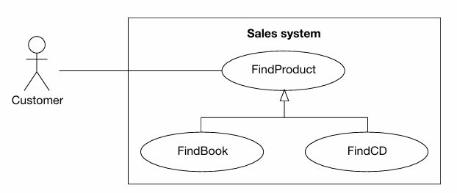

Slide 6
<<include>> Relationship
The «include» relationship extracts common behavior that is shared between multiple use cases, and puts it into a separate reusable use case.
Why use «include»?
When multiple use cases have repetitive steps, instead of writing the same thing again and again, you:
Extract those common steps into a new use case.
Use the «include» relationship to include that new use case wherever needed.

Slide 7
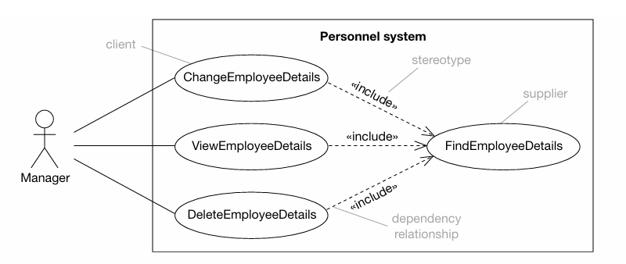
<<include>>

Slide 8
<<extend>> Relationship
The «extend» relationship is used when a use case optionally adds behavior to another use case under certain conditions.
Why use «extend»?
Use «extend» when you have a base use case, and sometimes, depending on a condition or situation, you want to extend its behavior.
The extended part is not always executed — only when a specific condition is true.

Slide 9
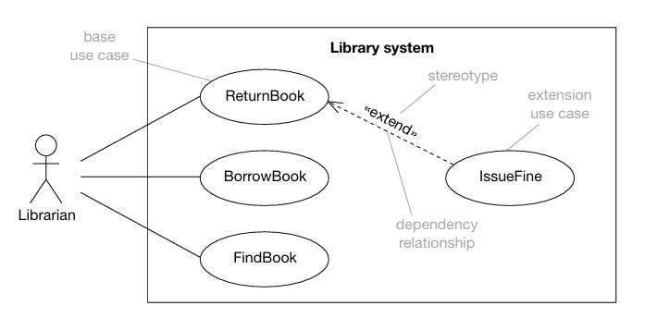
<<extend>>

Slide 10
Case Study -
Online Food Delivery System
Part 1 — Understand the System
define the system boundary.
System -
Online Food Delivery System is responsible for:
Customer management
Restaurant management
Order management
Payment management
Delivery management
Offers and coupons
Reviews and ratings
Notifications
Part 2 — Finding Actors
Customer
Restaurant
Delivery Partner
Payment Gateway
Notification Service

Slide 11
Case Study -
Online Food Delivery System
Part 3 — Identify Basic Use Cases
Customer -
Register
Login
Search Restaurant
View Menu
Place Order
Make Payment
Track Order
Cancel Order
Apply Coupon
Rate Order
Restaurant Staff -
Manage Menu
View Order
Accept Order
Reject Order
Update Order Status
Delivery Partner -
View Delivery
Accept Delivery
Update Delivery Status
Confirm Delivery
Payment Gateway -
Process Payment
Notification Service -
Send Notification

Slide 12
Case Study -
Online Food Delivery System
Part 4 — Actor Generalization
Regular Customer
Search restaurants
Place orders
Make payments
Track orders
Premium Customer
Can do everything a regular customer can do, plus:
Get priority delivery
Receive special offers
Get premium discounts
Another possible Actor Generalization
Suppose the system has:
Delivery Partner
Delivery Supervisor
A Delivery Supervisor can perform all activities of a Delivery Partner, plus supervise multiple deliveries.

Slide 13
Case Study -
Online Food Delivery System
Part 5 — Use Case Generalization
The general activity is: Make Payment
But payment can be performed through:
Card Payment
UPI Payment
Cash Payment
Part 6 — Another Use Case Generalization
Suppose the customer can communicate with the restaurant in two ways:
Send Text Message
Send Voice Message
Both are specialized forms of: Send Message

Slide 14
Case Study -
Online Food Delivery System
Part 7 — Finding <<include>>
When the customer makes an online payment, is authentication required.
Make Payment - - - - - - - - - - -> Authenticate Payment
<<include>>
Place Order
Before the system confirms an order, it must: Calculate Order Total
Place Order - - - - - - - - - - -> Calculate Order Total
<<include>>
Before confirming an order, the system must check whether the restaurant can accept the order.
Place Order - - - - - - - - - - -> Check Restaurant Availability
<<include>>

Slide 15
Case Study -
Online Food Delivery System
Part 8 — Finding <<extend>>
Place Order
Sometimes the customer applies a coupon.
But does every customer use a coupon?
No.
Apply Coupon - - - - - - - - - - -> Place Order
<<extend>>
Part 9 — Another extend Example
After an order is delivered, the customer may rate the restaurant.
Not every customer has to provide a rating.
Rate Order - - - - - - - - - - -> Complete Order
<<extend>>

Slide 16
Case Study -
Online Food Delivery System
Part 10 — Conditional Extension
Suppose a customer cancels an order.
The system normally processes: Cancel Order
But if the order has already been prepared, the system may require: Cancellation Reason
Provide Cancellation Reason - - - - - - - - - - -> Cancel Order
<<extend>>

Slide 17
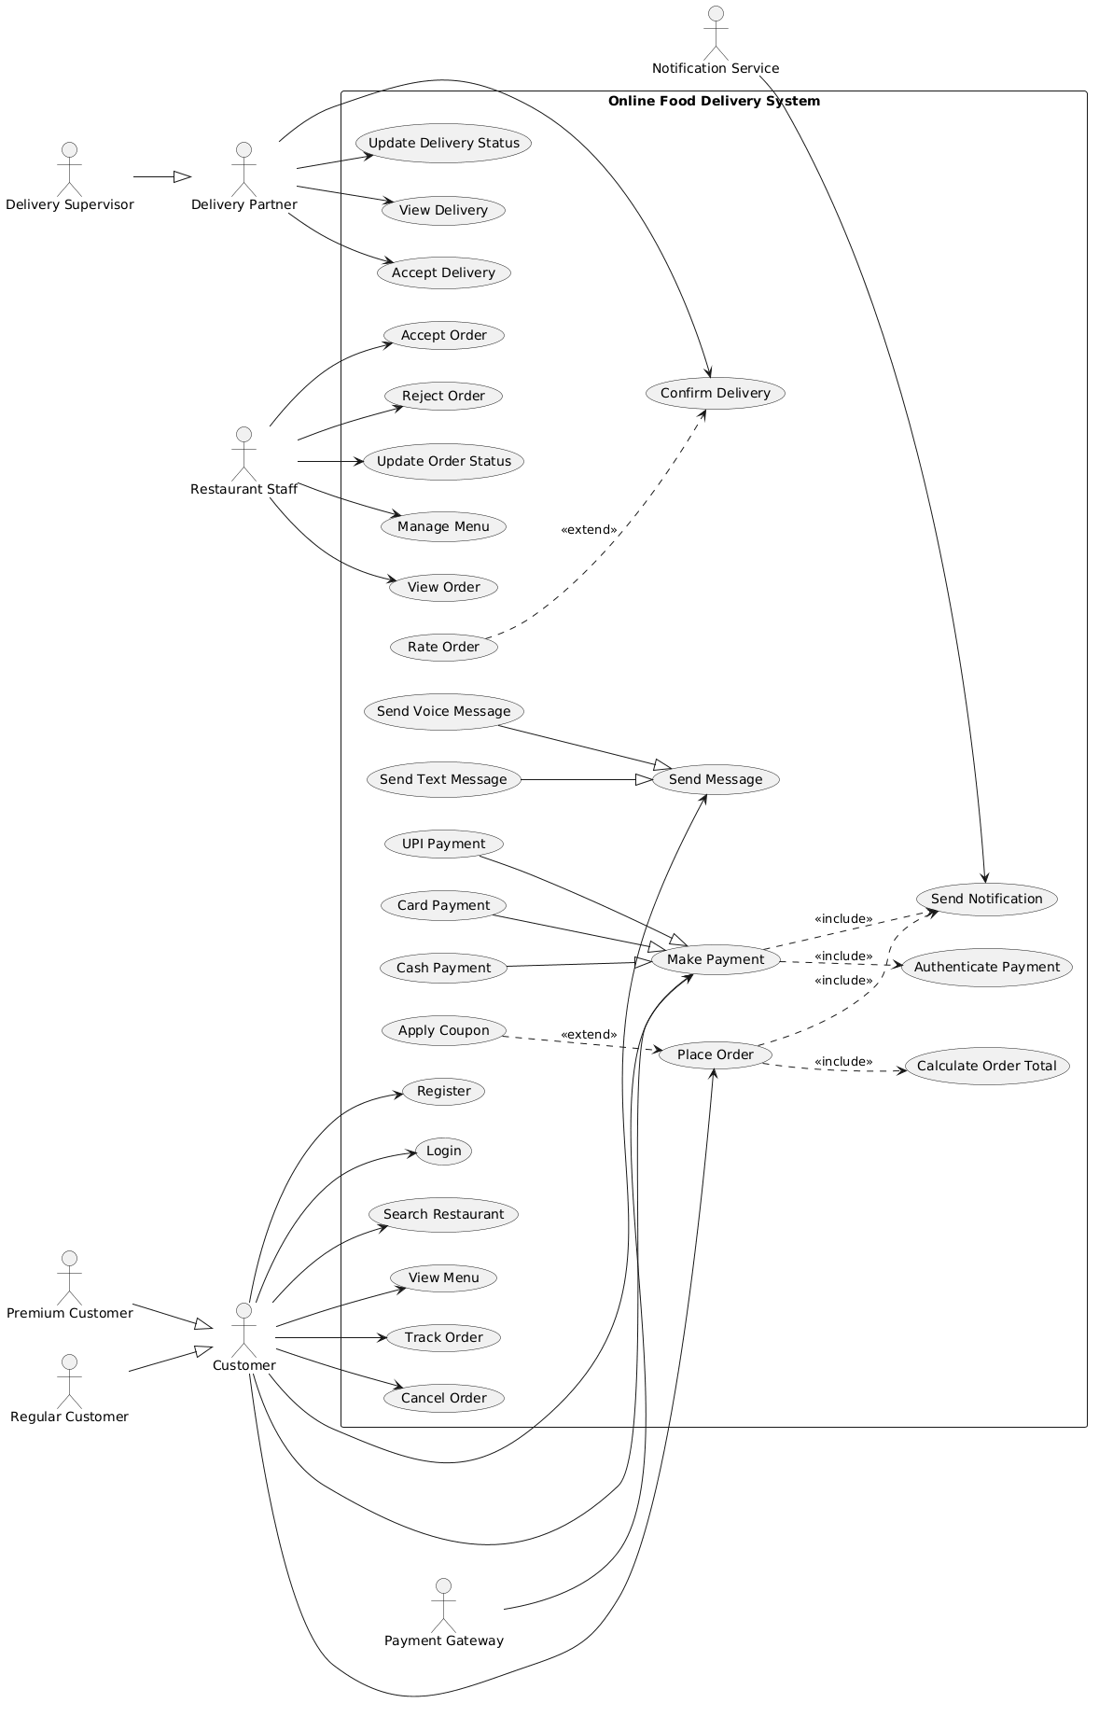

Slide 18
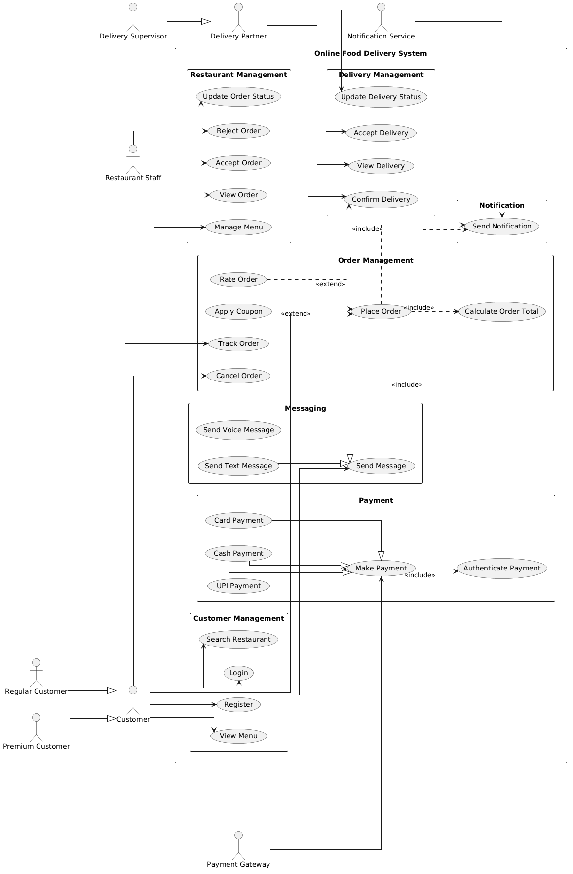

Slide 19
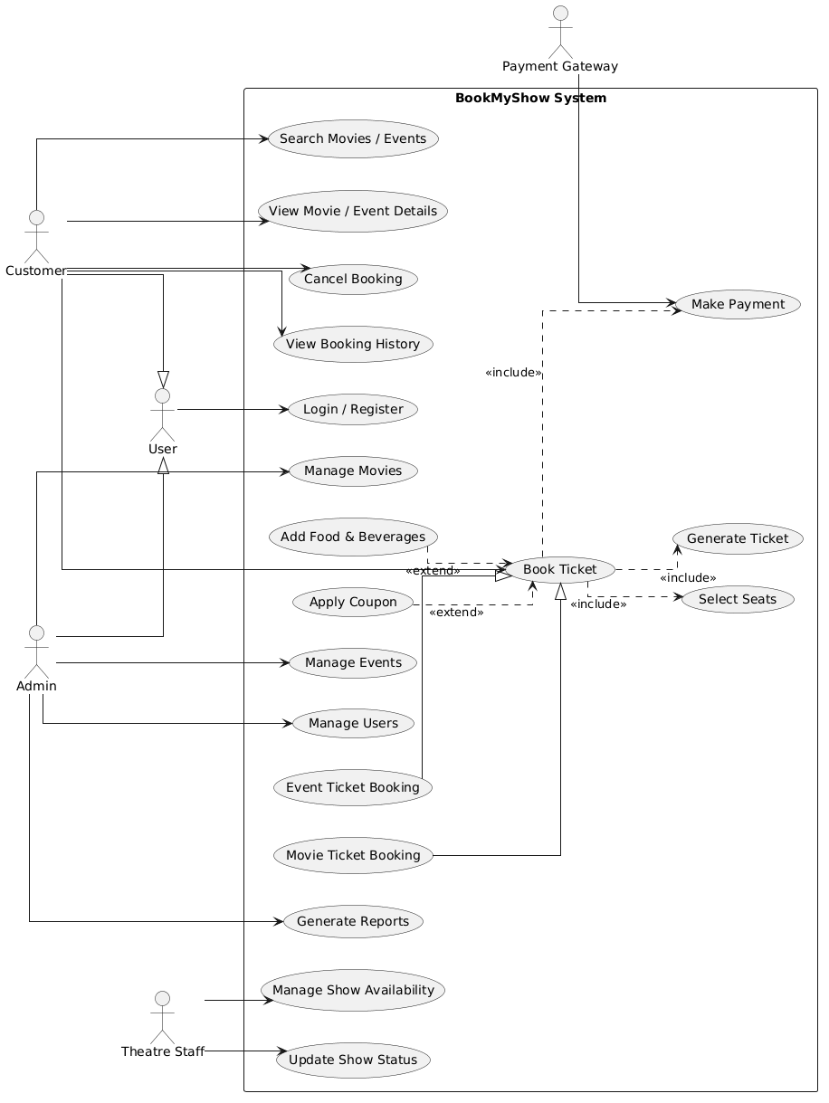

Slide 20
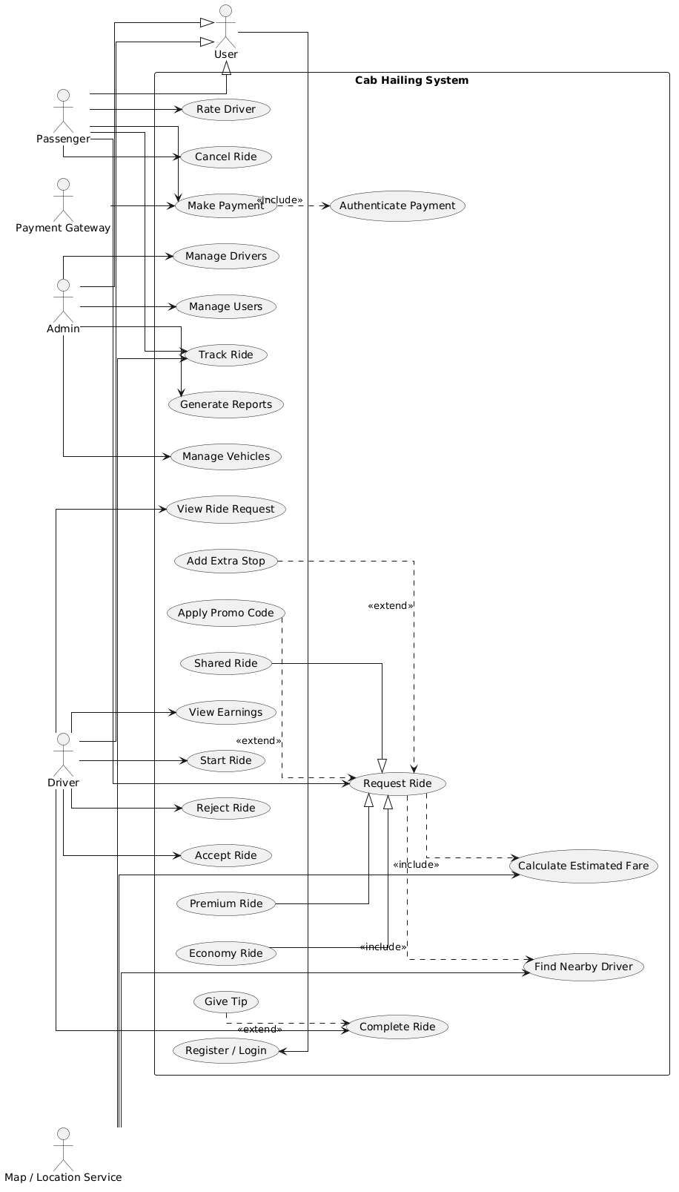

Slide 21
Case Study -
University Course Registration
Design a UML Use Case Diagram for a University Course Registration System with the following requirements:
A university course registration system is used by Students, Faculty Members, Department Heads, and Administrators.
A Student can Search Courses, Register Course, Drop Course, View Timetable, View Results, and Add Course to Wishlist.
Students are specialized into Undergraduate Student and Postgraduate Student.
A Faculty Member can View Courses, Manage Attendance, and Upload Marks.
A Department Head is a specialized Faculty Member and can additionally Approve Course Registration.
An Administrator can Manage Students, Faculty, and Courses.
During Register Course, the system must Check Prerequisites, Check Seat Availability, and Validate Student Eligibility.
A student may optionally Add Course to Wishlist before registration.
Identify and model suitable Use Case Generalization among related use cases.
Your diagram must clearly demonstrate:
Actor Generalization
Use Case Generalization
<<include>> relationships
<<extend>> relationship
Correct system boundary and actor associations.

Slide 22
THANK YOU

